Slide 1
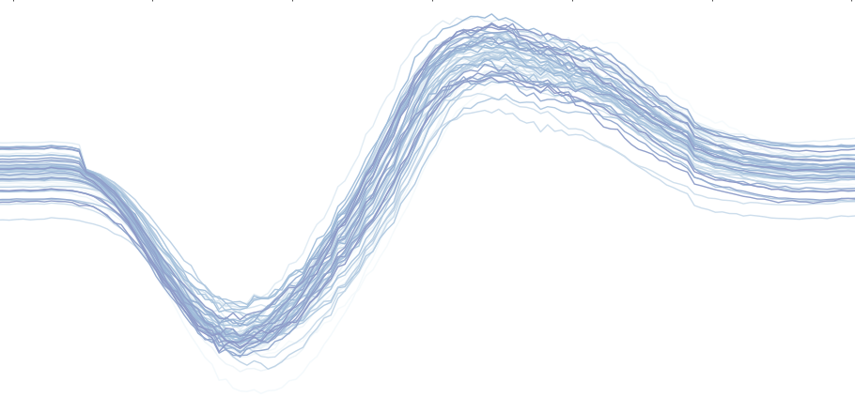
latest findings from the pulseshape scan
- BCID offset, pulseShape, l0Latency
Mariana Rihl, 14.12.2016

Slide 2
ODIN BCIDs vs LHC filled buckets
Run 1588, fill 4873: one pilot bunch and one bunch per beam.
The red lines indicate the beam2 filled buckets.
Task: match the ODIN bcids with the LHC beam2 filled buckets
Run 1589, fill 4874: 12 bunches per beam.
The red lines indicate the beam2 filled buckets. The tall blue lines (order of 10³) represent the filled buckets from beam2, the shorter ones (order of 10) indicate the interactions from beam 1.

Slide 3
BCID offset from runs 1588 and 1589
shifted ODIN bcids to align with filled buckets from timber.
run 1588: fill 4873, one pilot bunch and one bunch per beam
run 1589: fill 4874, 12 bunches per beam.
Got filled buckets from timber and offset through comparison of ODIN bcids.
Could verify offset through fill 1589.

Slide 4
good results for activity “PULSESHAPESCAN”

Slide 5
good results for activity “PULSESHAPESCAN”

Slide 6
good results for activity “PULSESHAPESCAN”
Run 1950, 01.12.2016
low statistics because only 100 evtens per step.
BCID is structure still visible.

Slide 7
…but it doesn’t always work...

Slide 8
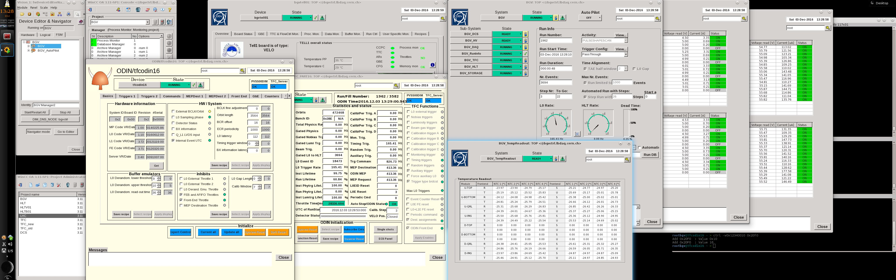
why?!
Runs 1711, 1712, 1937: physics runs
Run 1962: pulseshapescan with wrong settings (no timing trigger window, no external bunch clock)

Slide 9
possible explanations
need to activate “External BCLK/Orbit” in TFC panel to get correct bcid distribution
timing trigger activated
L0Accept and FE Reset of CB need to be 5ns earlier than Clock signal.
settings for PHYSICS: L0A, FER=0ns, Clk = 13ns
settings for PULSESHAPESCAN: L0A, FER = 5ns, Clk = 13ns (ns+=1 per step)

Slide 10
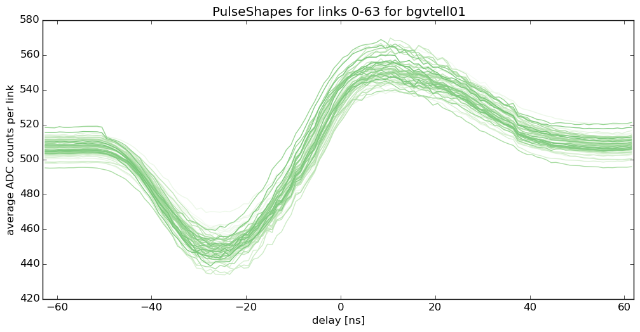
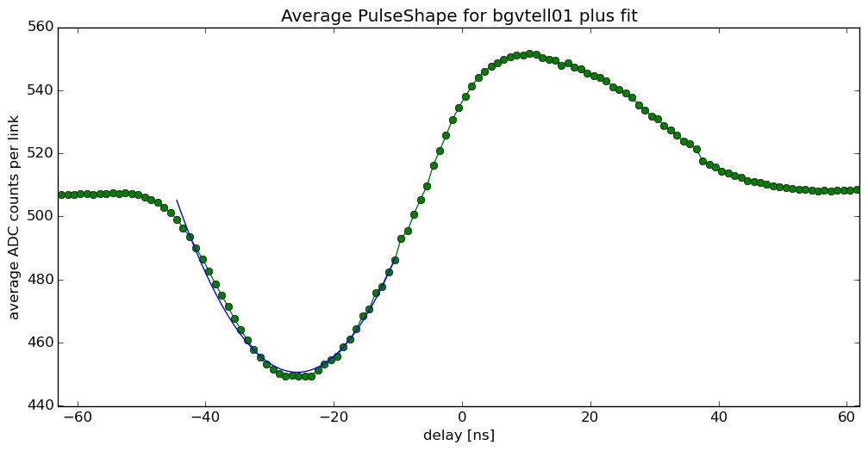
PulseShapeScan Analysis
Runs before trigger changes (and fw changes)
Run 1589 (27.04.2016), bgvtell01.
l0latency = 113 (assumed optimal slot at l0latency 115)
Run 1589, average over all links, including fit with second degree polynomial

Slide 11
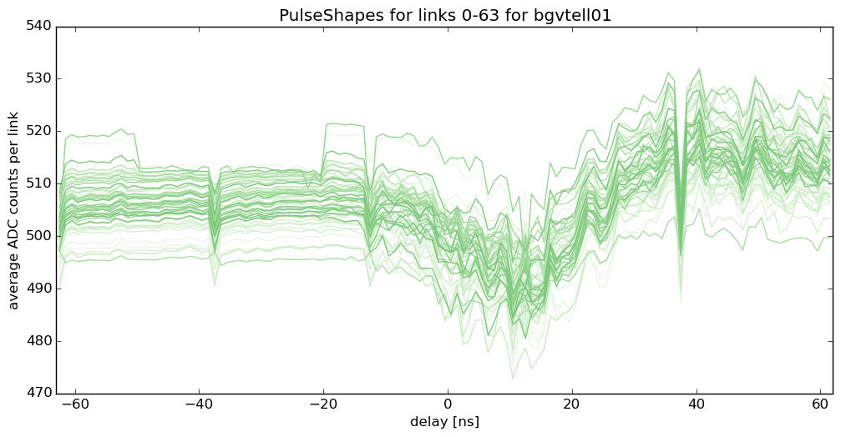
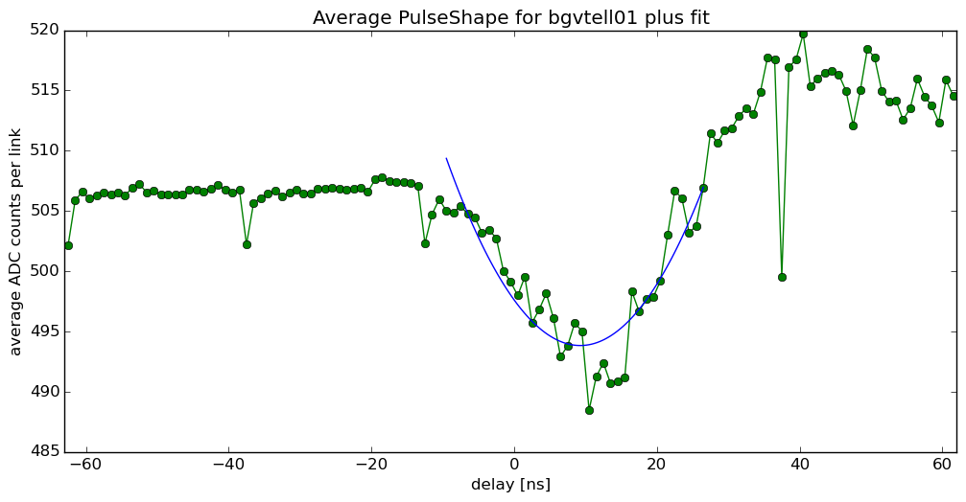
PulseShapeScan Analysis
Still no reason why MEP requests are bad for recent PSS
took data with 100 evts per step, slightly weird behaviour
Run 1948
analysis ignores “bad events”, events that have no Previous/Next data while keeping the counter running correctly.
Regular spikes are strange, they seem to occur at step 1 most.
Could try to improve shape by also using ODIN event number.
questionable if fit is precise enough.
Idea is to take minimum of fit, take closest ns value and translate this into Clk/L0A/FER settings for CB

Slide 12
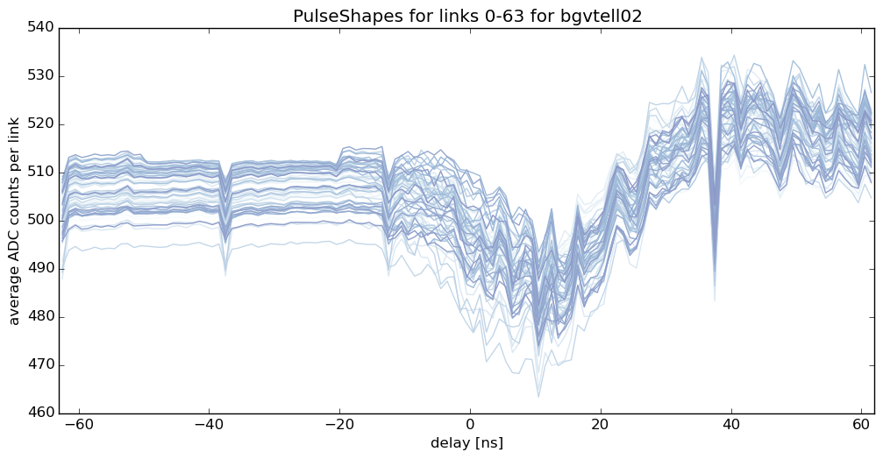
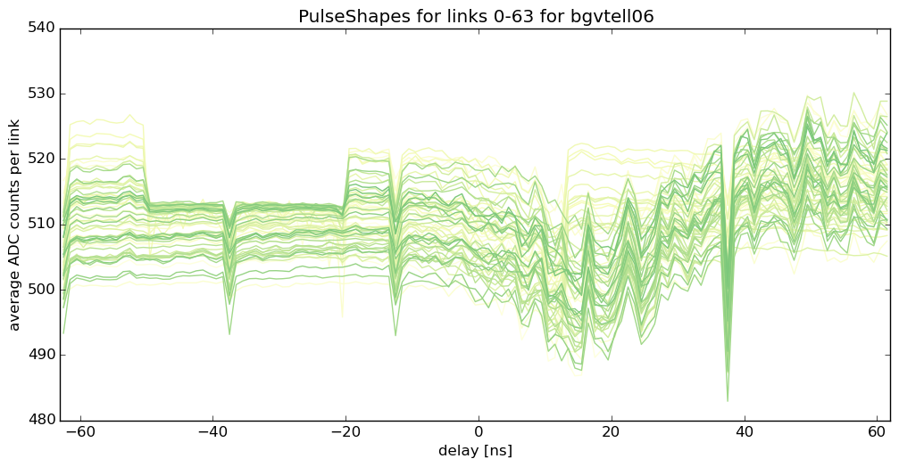
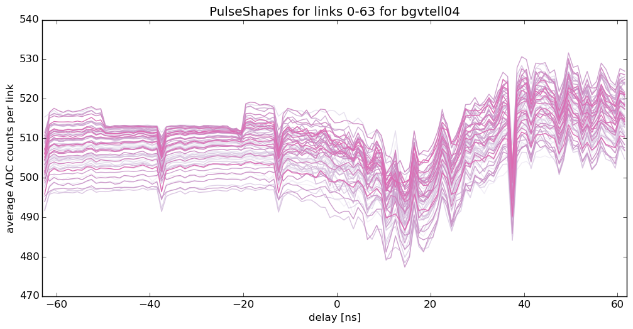
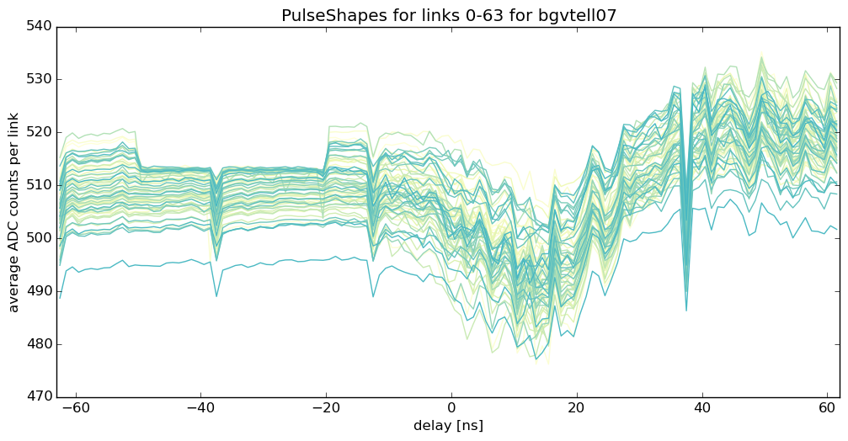
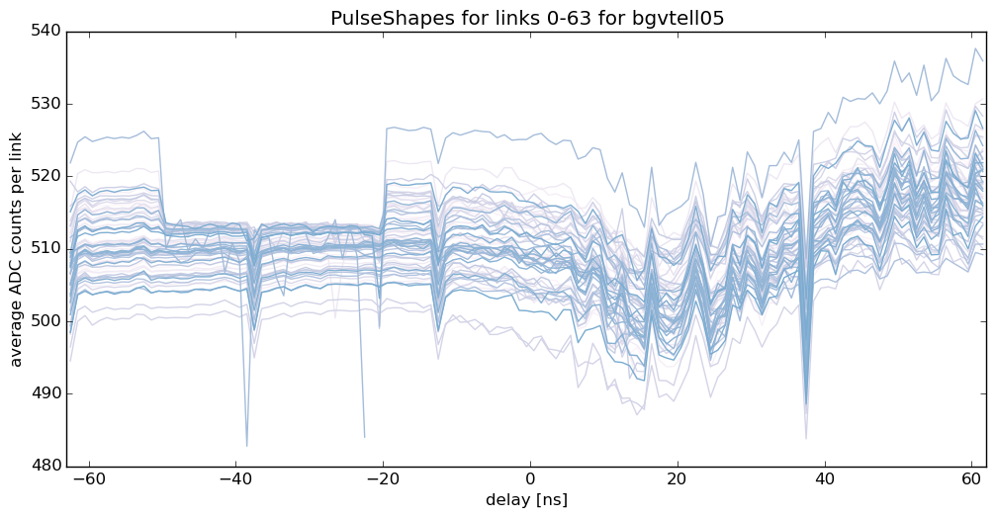
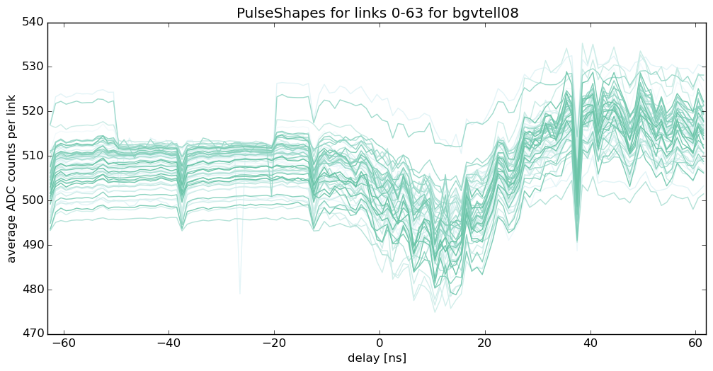
Run 1948

Slide 13
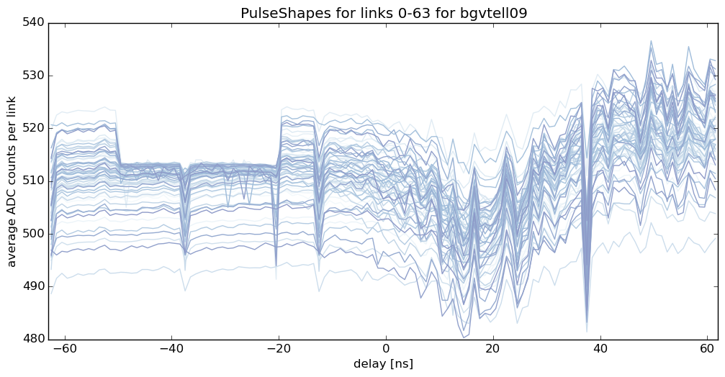
Run 1948

Slide 14
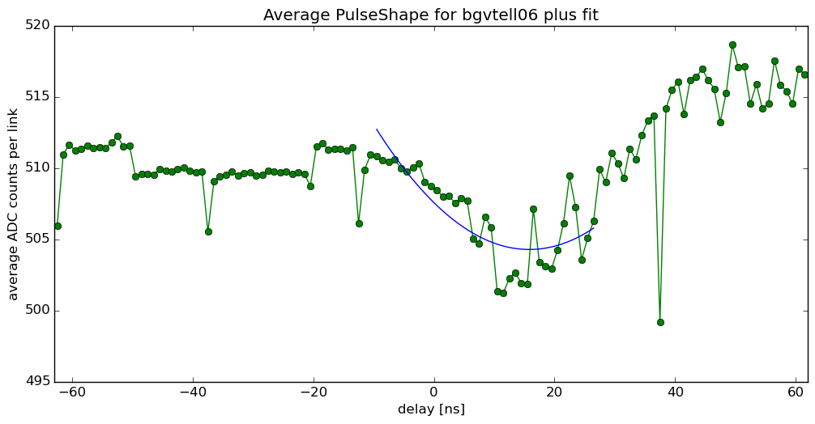
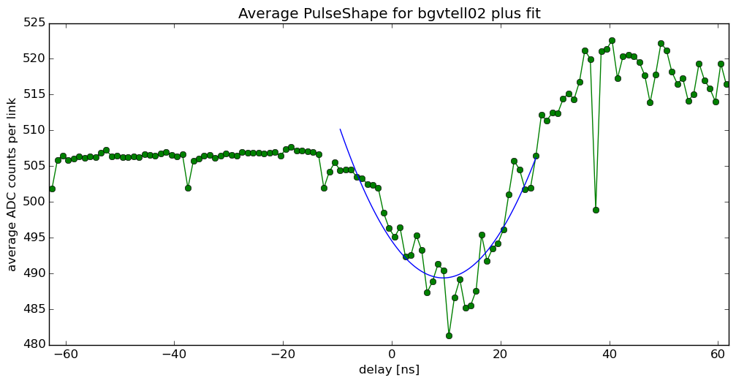
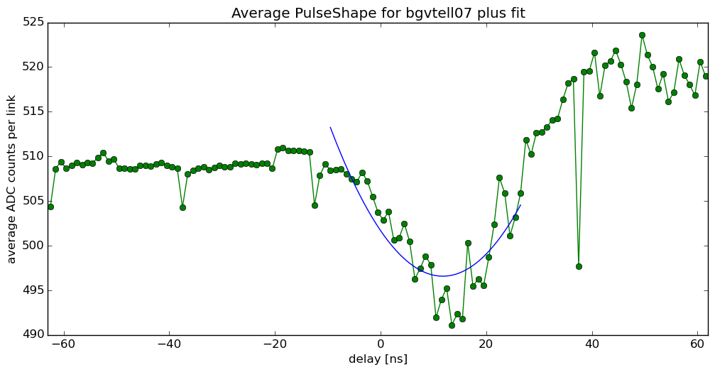
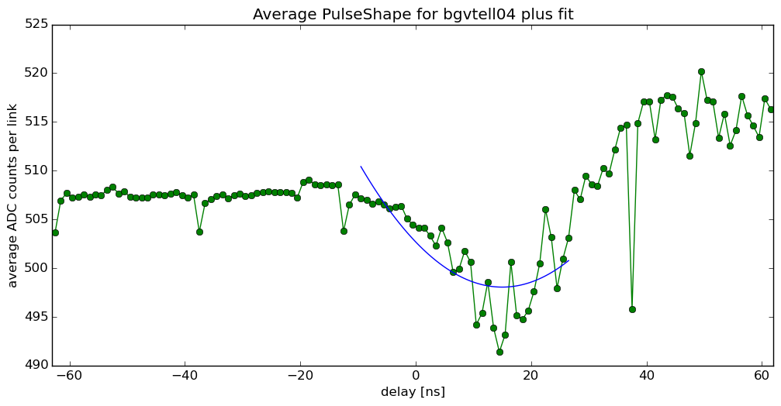
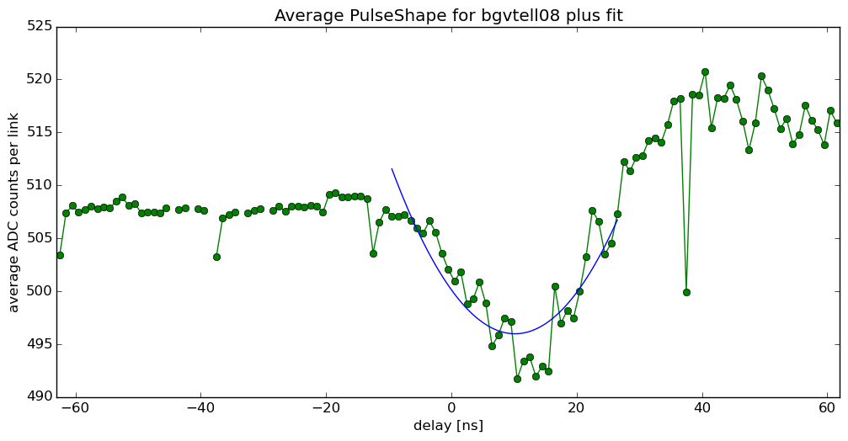
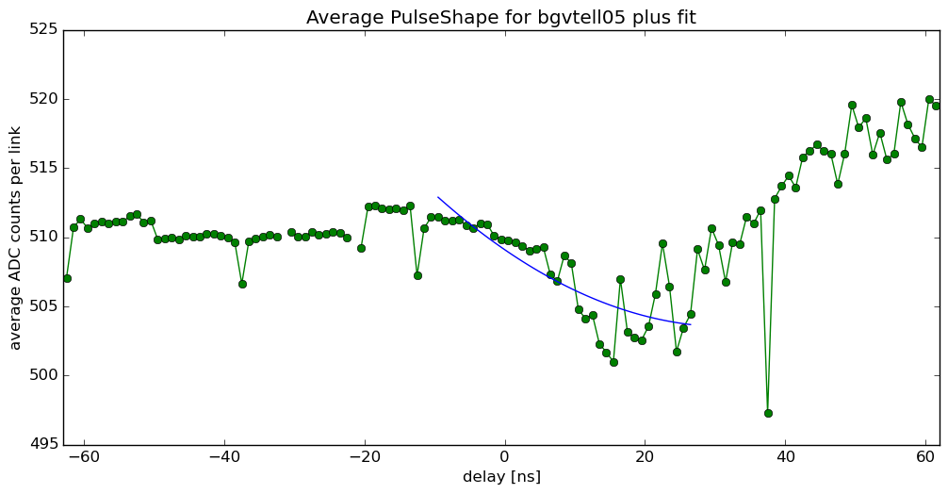
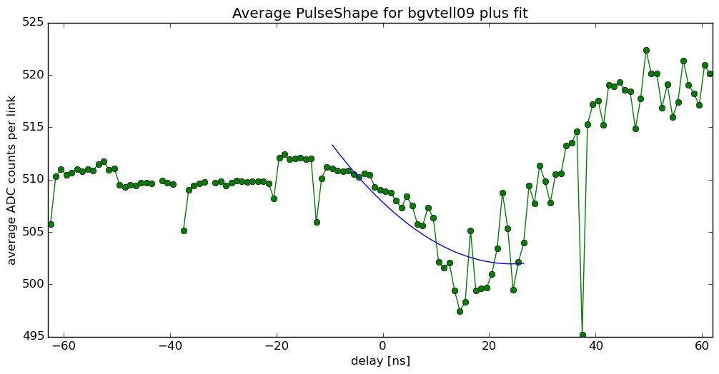
Run 1948 fits of average pulseshapes per Tell1

Slide 15
L0Latency scan
took runs with TAE = 3 and l0latency 111
1000 events, 7 samples per event, one step only
Run 1963: L0A, FER = 0ns, Clk = 13ns
Run 1965: L0A, FER = 18ns, Clk = 13ns
Run 1963 implies optimal l0latency delay being 115
Run 1965 implies optimal l0latency delay being 114
since PulseShapeScan has same L0A/FER offset to clock, as Run 1965, this should be used for the future and also implemented for PHYSICS runs.

Slide 16
Conclusion
l0 latency at 114 is optimal
change settings in physics recipe: ODIN: always enable the external BCLK/Orbit
CB (hybrid): L0A, FER needs to be 5ns bigger than Clock to get a good pulse shape
(e.g. L0A, FER = 18ns, Clk = 13ns)

Slide 17

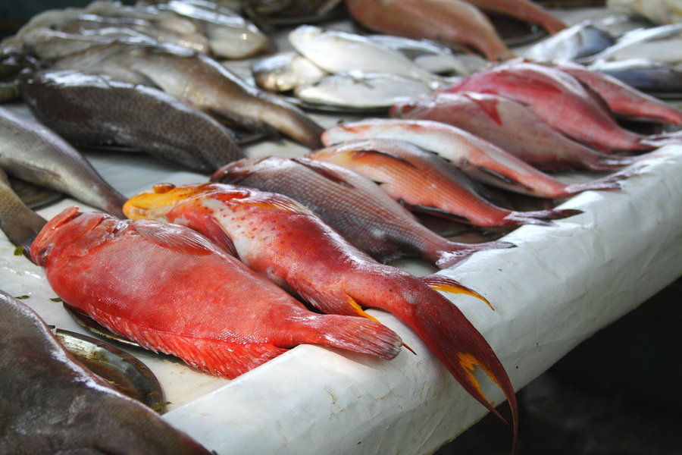
so long…
...and thanks!

